Slide 1
Peet’s Coffee and Tea
Rebranding to Target Millennials
Aayam Poudel
Vaughn Gooding
Bonnette Ishimwe Claudia Huerta

Slide 2
Opportunity
Market Peet’s Coffee and Tea to millennial coffee connoisseurs.

Slide 3
Solution
Sell an experience while telling the Peet’s story.

Slide 4
Strategies
Connecting
consumers & producers
Sharing Peet’s story
Enhancing experience
while eliminating
inconveniences

Slide 5
Strategies
Connecting
consumers & producers
Sharing Peet’s story
Enhancing experience
while eliminating
inconveniences

Slide 6
Connecting
consumers & producers
“The millennial is into authenticity and more into authenticity than prestige.”
Helen Kellog Marketing Consultant Green Mountain Keurig

Slide 7
Connecting
consumers & producers
“History underscores the authenticity of the brand”
Roy Heffernan Former COO Life is Good

Slide 8
Connecting
consumers & producers
Millennials want to know what they’re buying.
Simplify the logo
Alfred Peet as the face of the company
Coffee bags
Redesign cup with supply chain

Slide 9
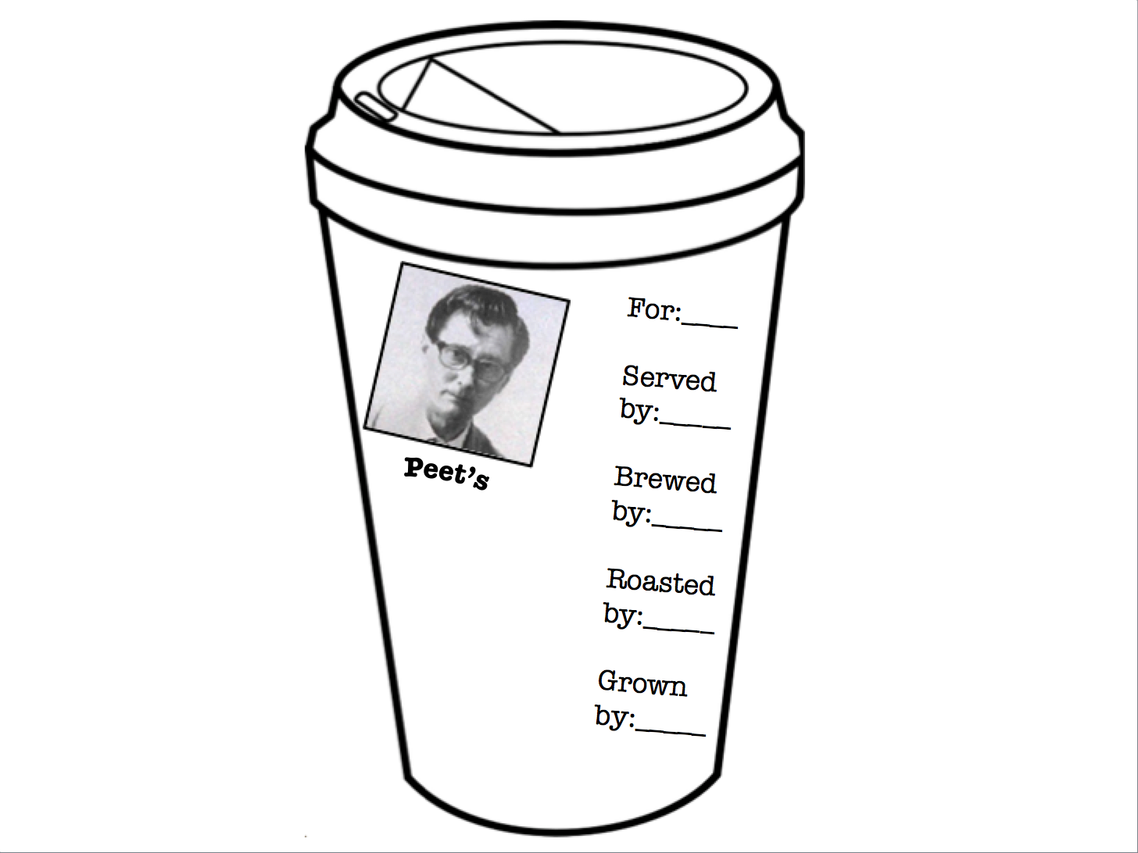

Slide 10
Strategies
Connecting
consumers & producers
Sharing Peet’s story
Enhancing experience
while eliminating
inconveniences

Slide 11
Enhancing the experience while reducing the inconveniences
“I don’t sit around and enjoy [coffee].”
Sarah (24 year old coffee drinker)

Slide 12
Enhancing the experience while reducing the inconveniences
Pre-order
Location tracking
Reward system
Millennials are always on the move.

Slide 13
Strategies
Connecting
consumers & producers
Sharing Peet’s story
Enhancing experience
while eliminating
inconveniences

Slide 14
Sharing the story
“If somebody recommended a product, it’s much better than a billboard.”
Helen Kellog Marketing Consultant Green Mountain Keurig

Slide 15
Sharing the story
“When telling a story it has to be honest and real… human to human connection.”
Cara Thomas Innovation Consultant Founder of Serenflipity Games

Slide 16
Sharing the story
To continue to reach out to Millennials, we need to collaborate with people they respect.
Instagram Campaign
Lifestyle bloggers
Tour
Share the experience

Slide 17
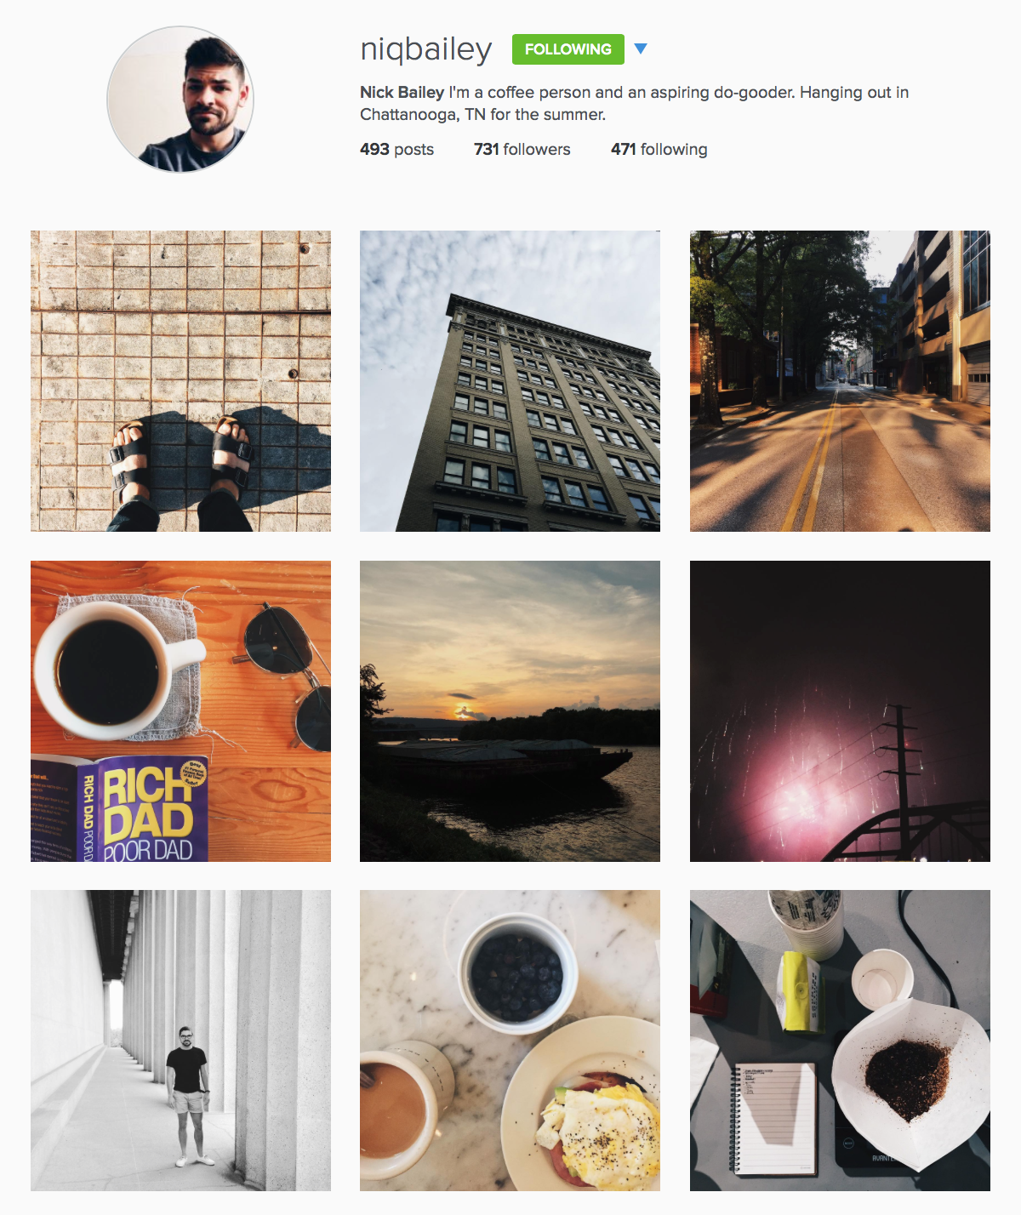
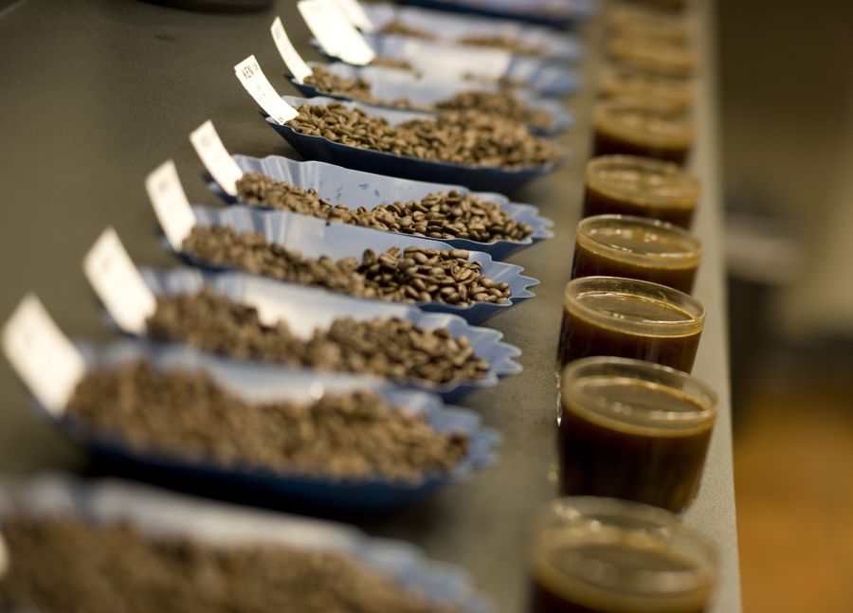
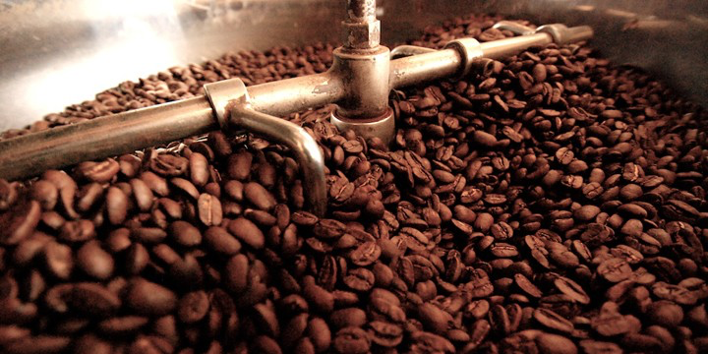
Millennial Connoisseurs

Slide 18
Takeaway
Connecting
consumers & producers
Highlight supply chain on cup
Root familiarity of product in Afred Peet’s image
Feature growers on coffee bags
Enhancing experience
while eliminating
inconveniences
App
Pre-order with geo-tracking
Bonus with download
Loyalty rewards
Sharing Peet’s story
Instagram campaign
Factory tours
Gain a foothold with influential millennials

